Slide 1



BREMS Updated Handtevy Mobile
Instructions for use and FAQs

Slide 2
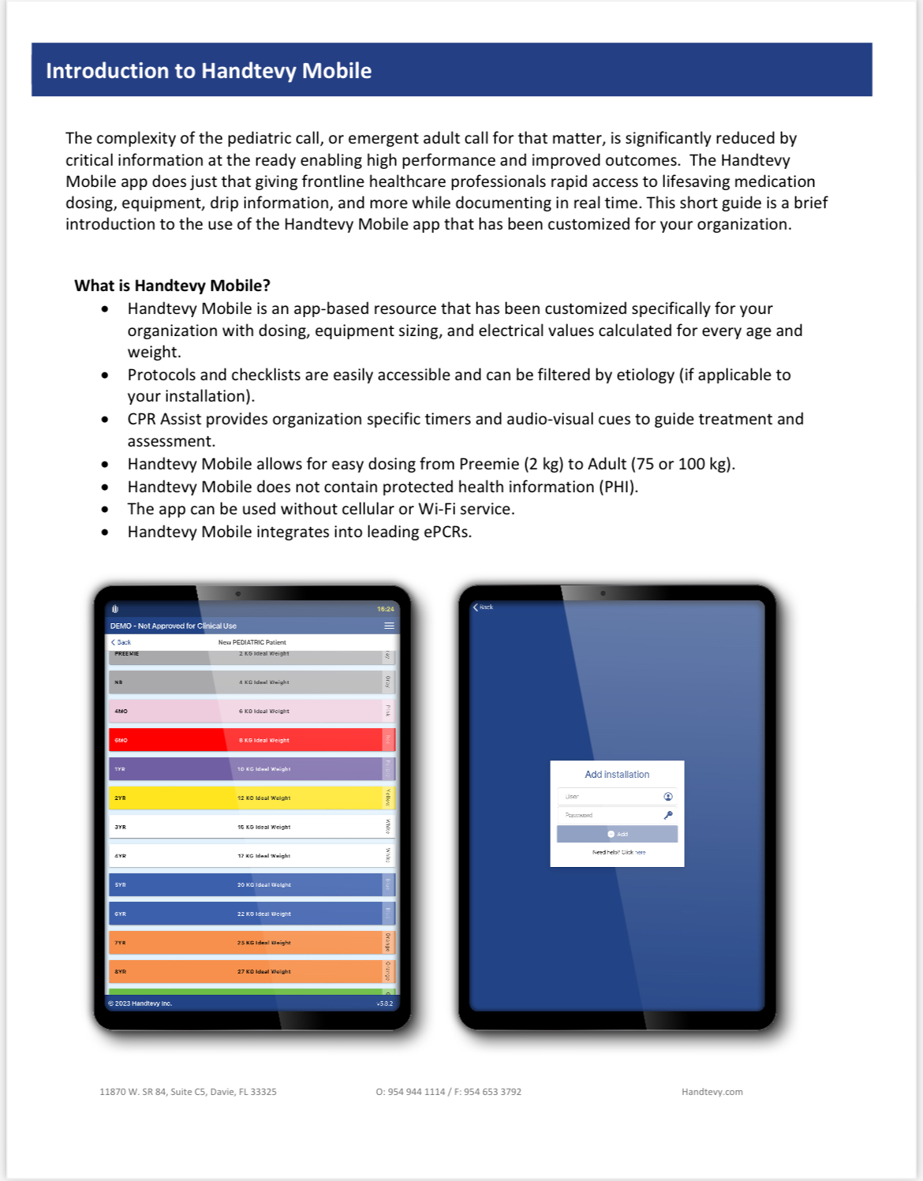

Slide 3
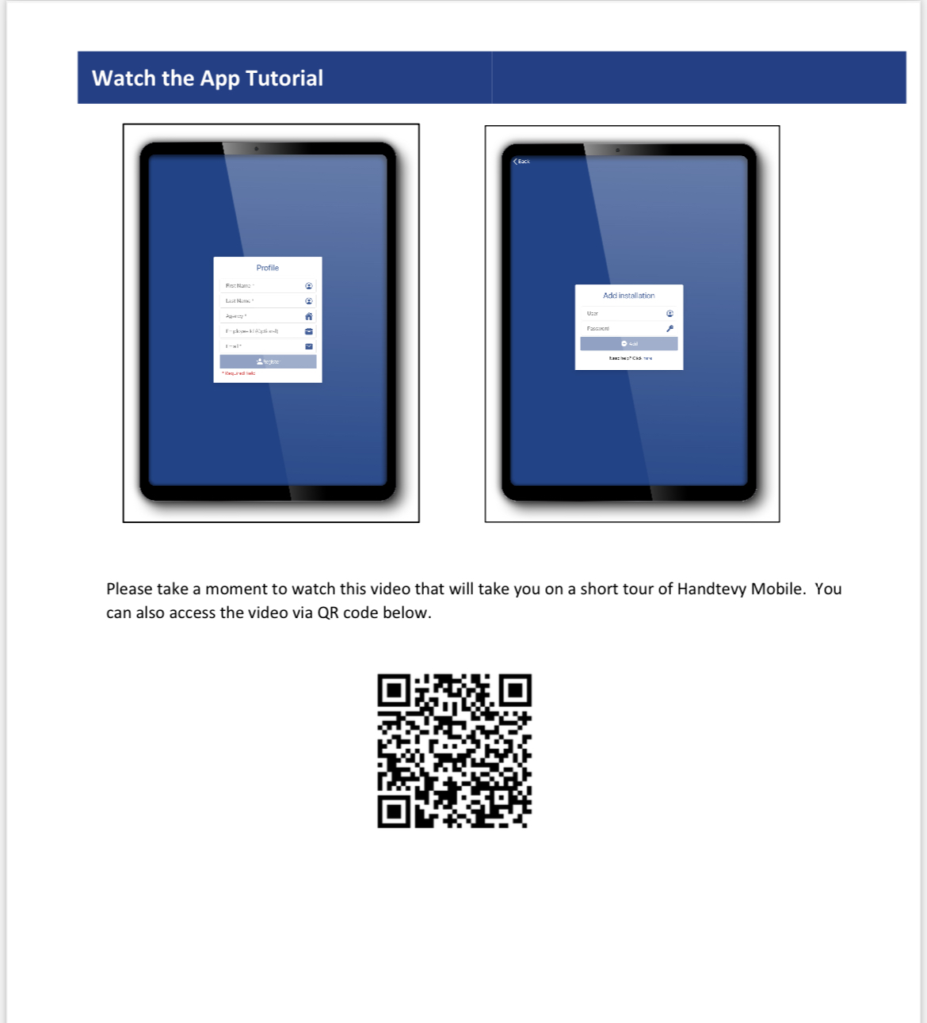

Slide 4
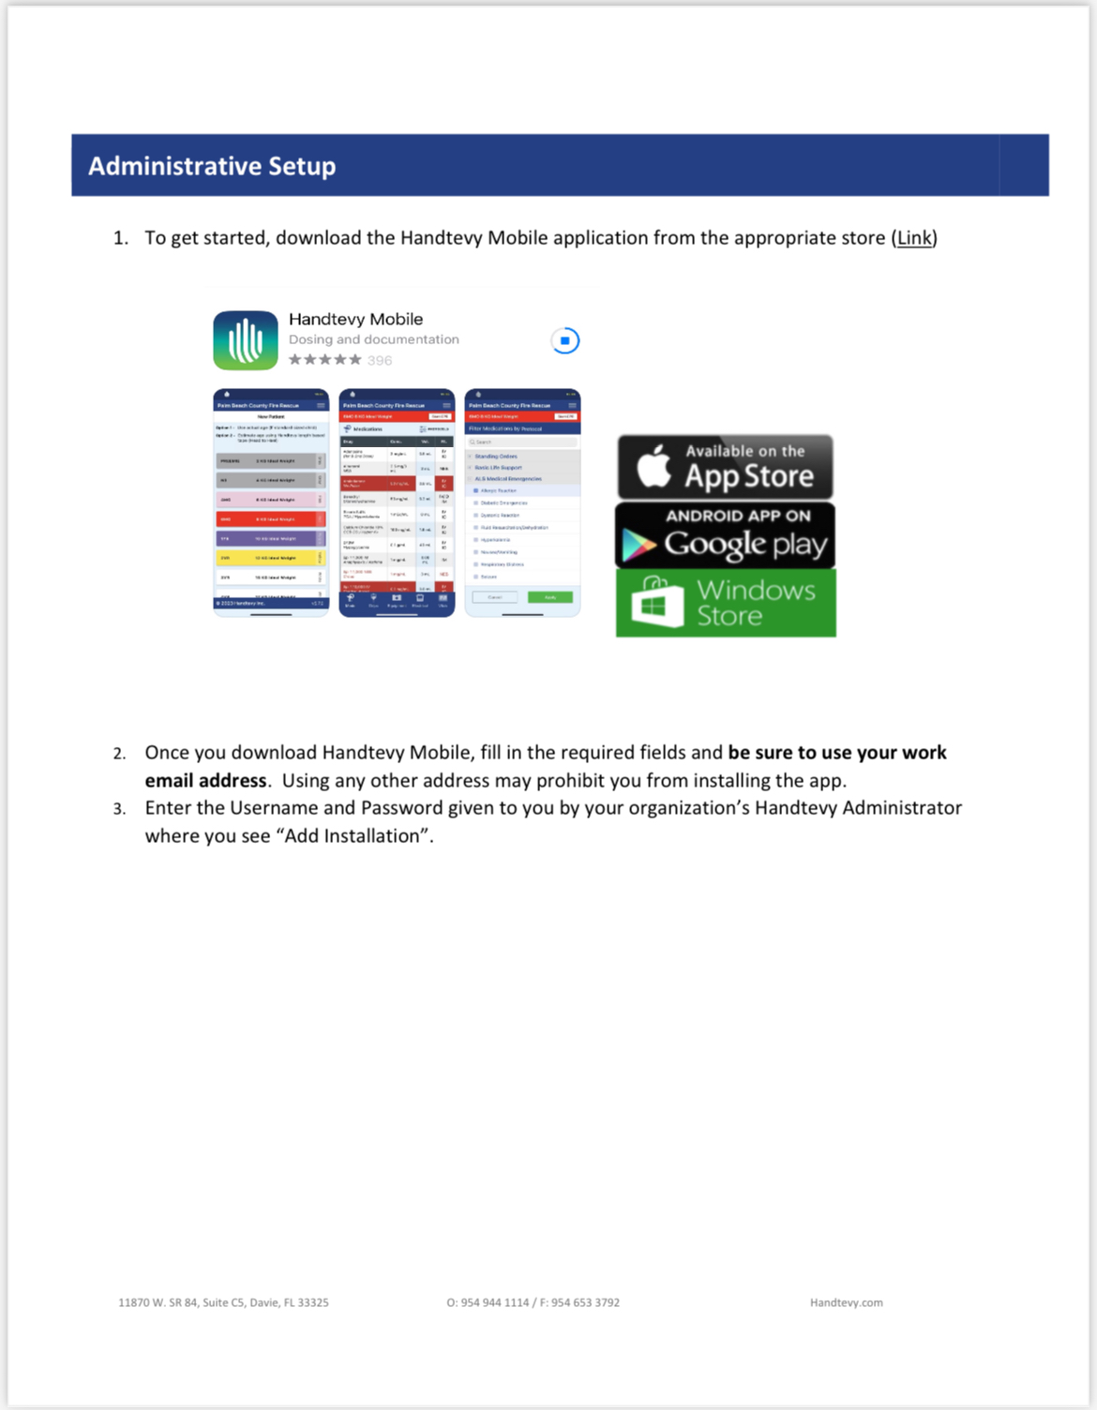
If you already have the BREMS Handtevy Mobile App, then you won’t need to download a new one.
Once you open the app, you should see a green bar across the bottom that says synchronizing update.
Username: BREMS1778
Password: BREMS1778

Slide 5
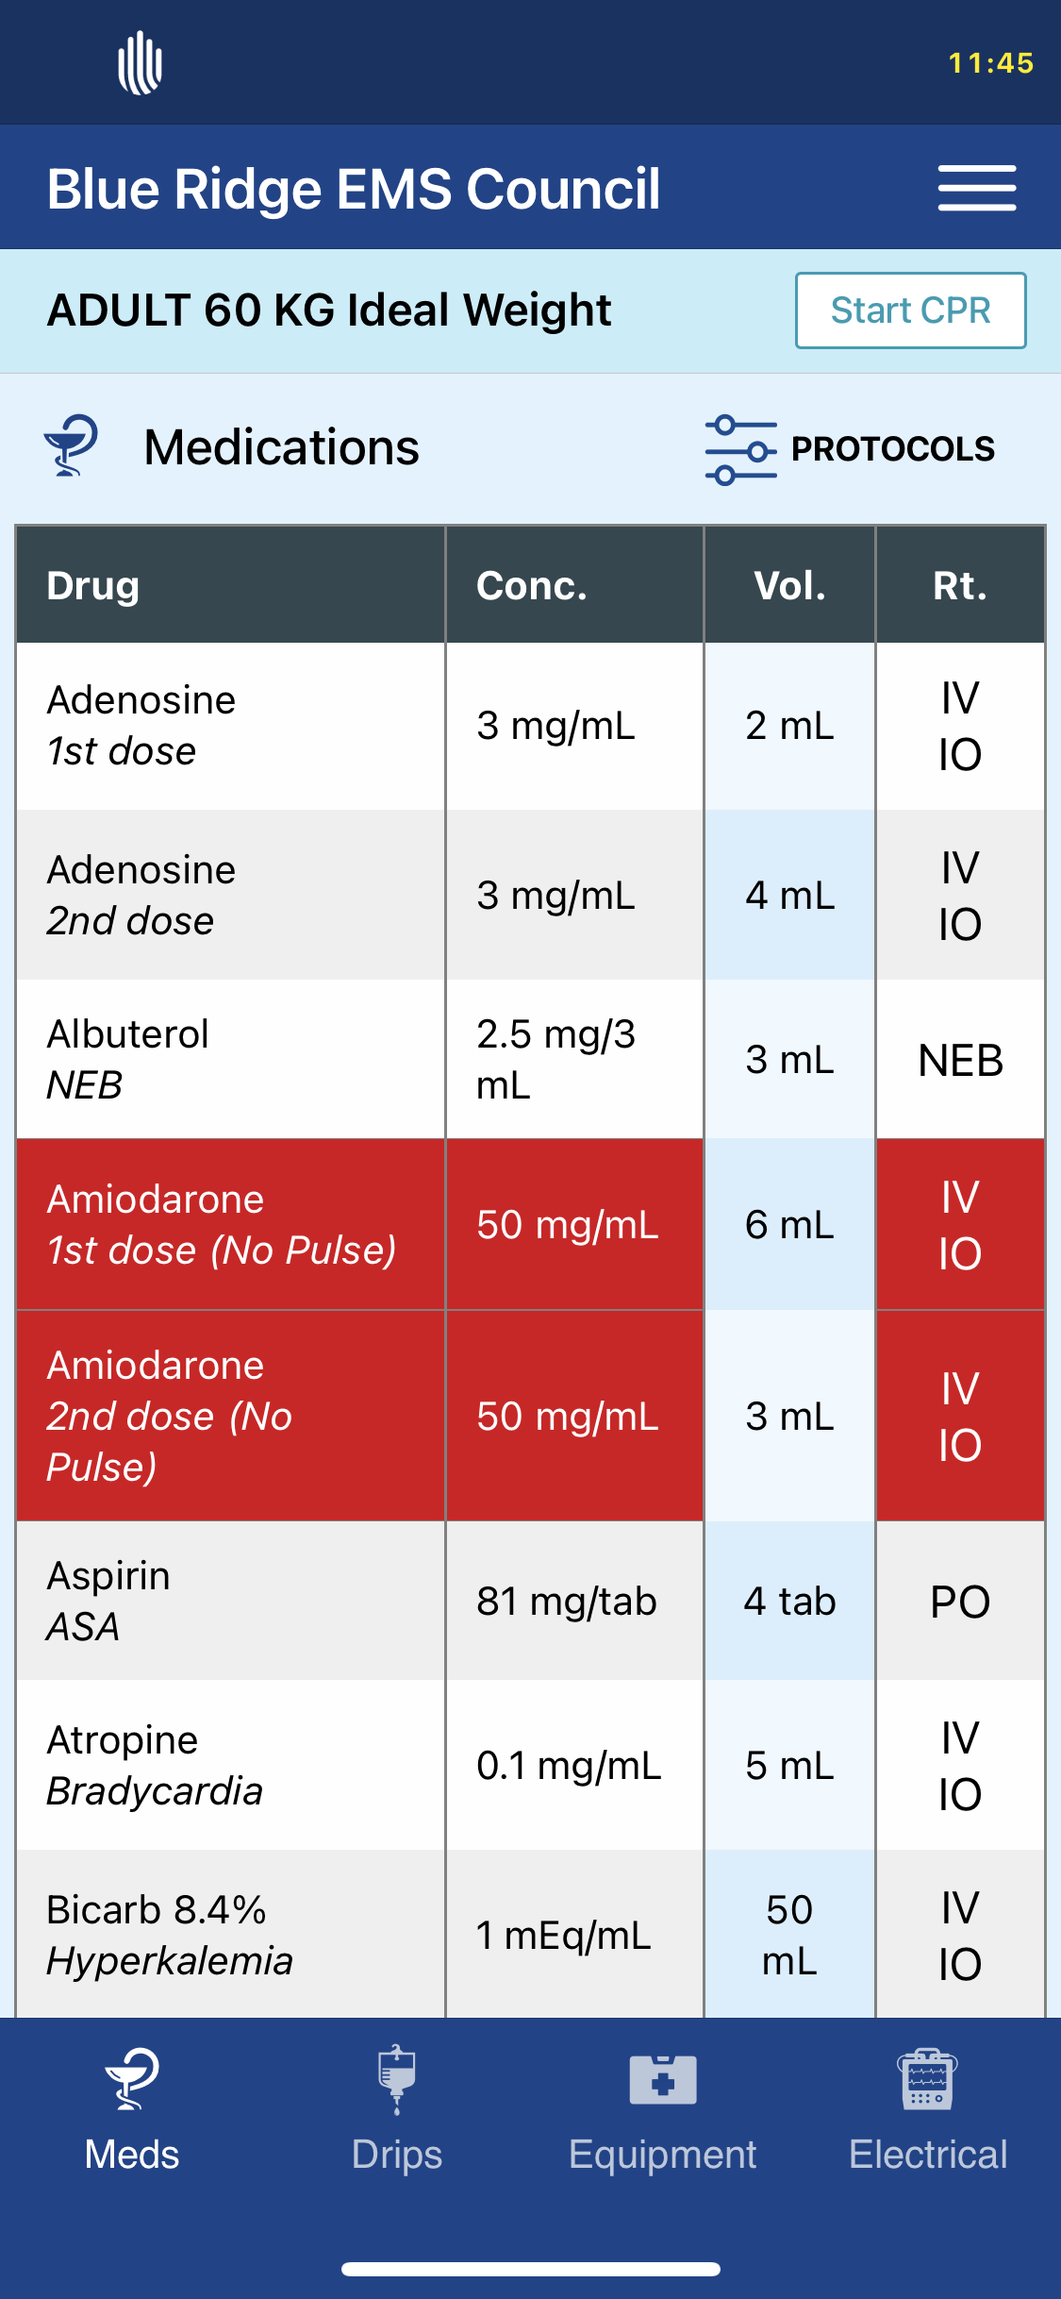
From the main screen, you will see the choice of Pediatric or Adult.
The new Adult tab now has choices for ideal body weight. Choose the appropriate weight that you need.
Here you will see where you can click on Protocols.
Clicking that will take you to a new page.

Slide 6
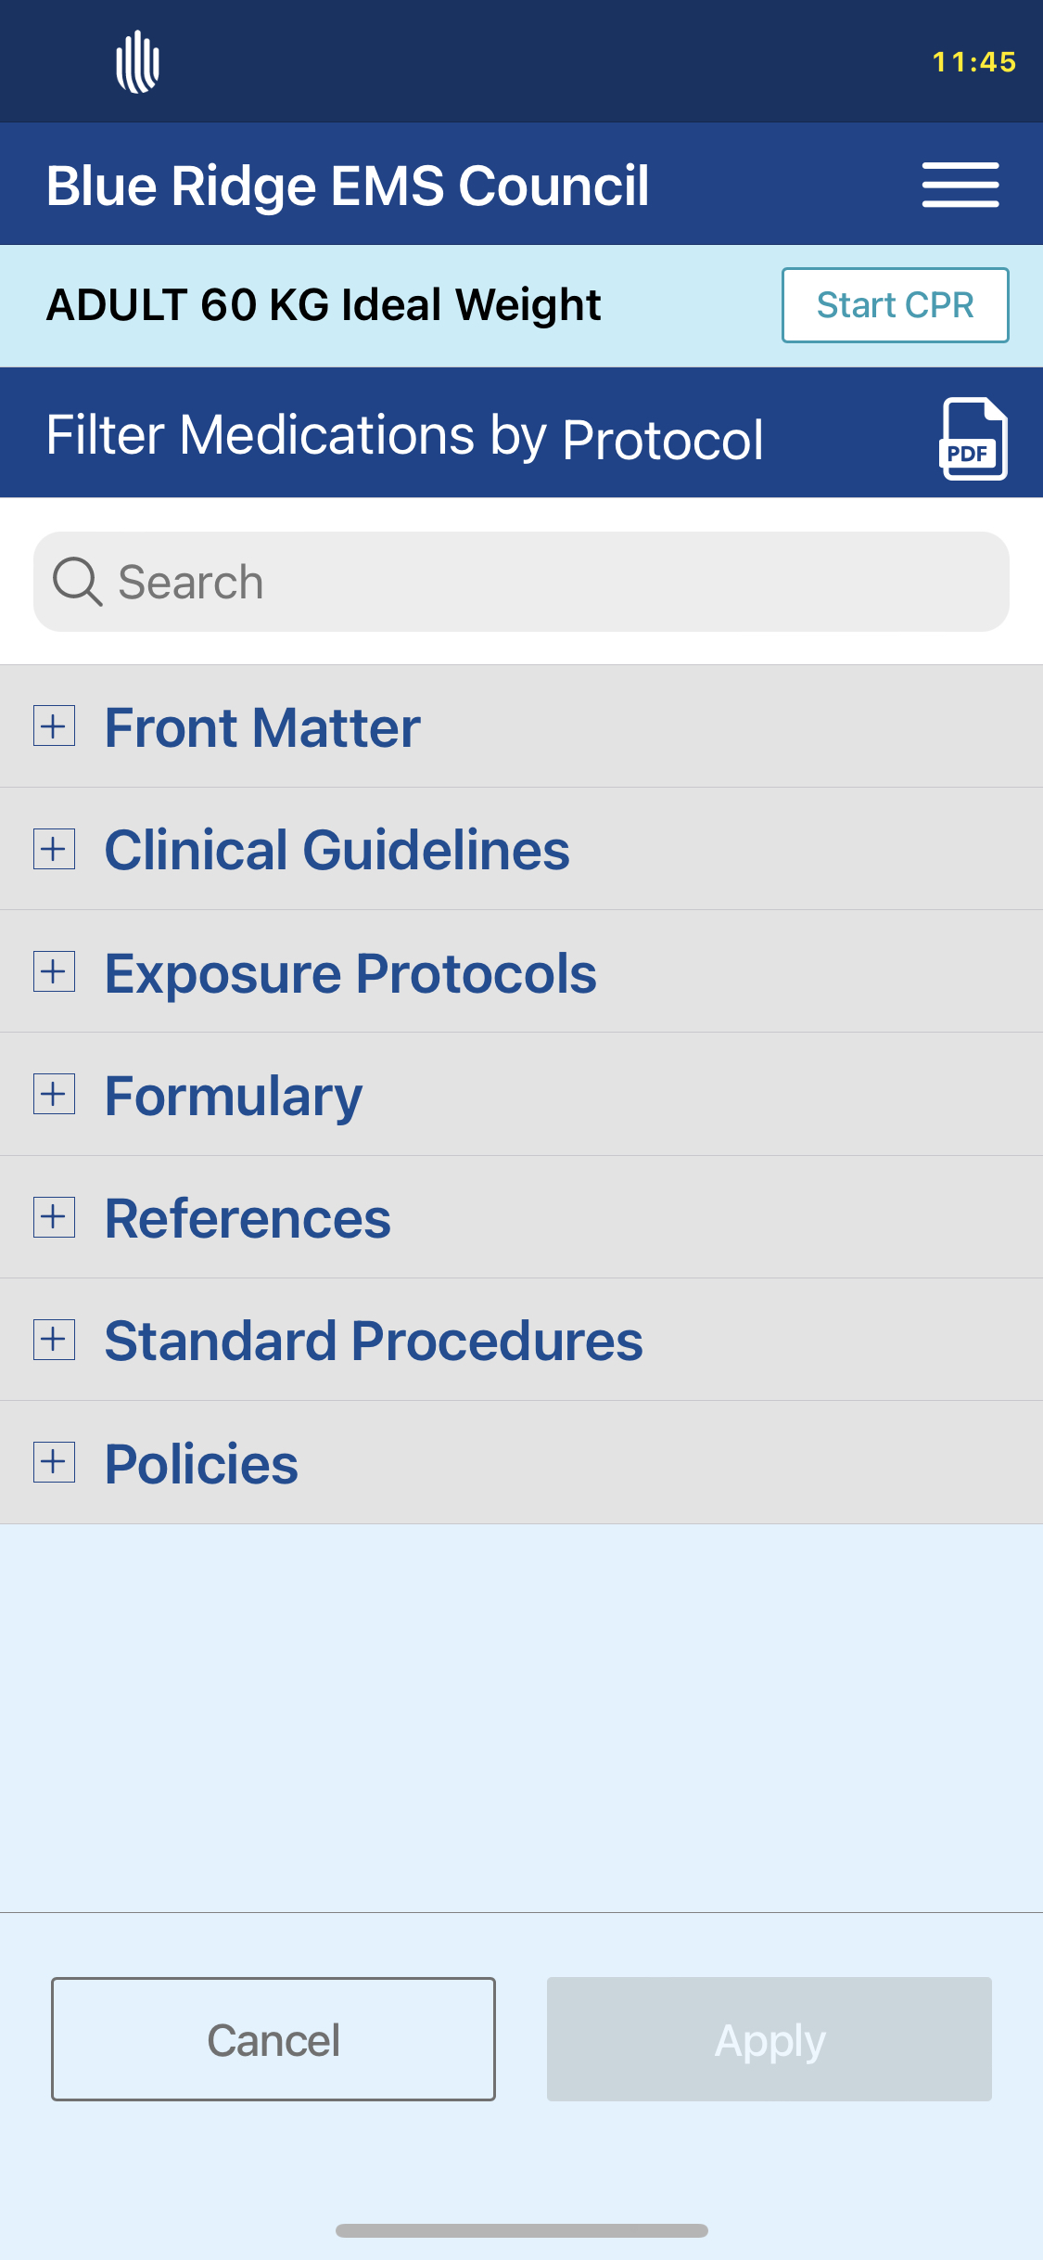
Here you can choose the protocol that applies to your patient condition.
Clicking on the + will expand the section.

Slide 7
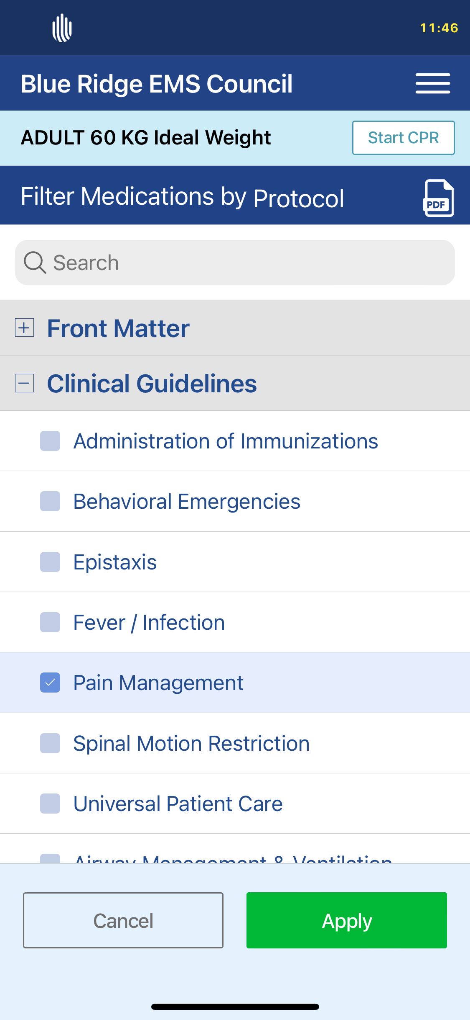
Clicking on the + will expand the section allowing you to chose which protocol suits your patient condition.

Slide 8
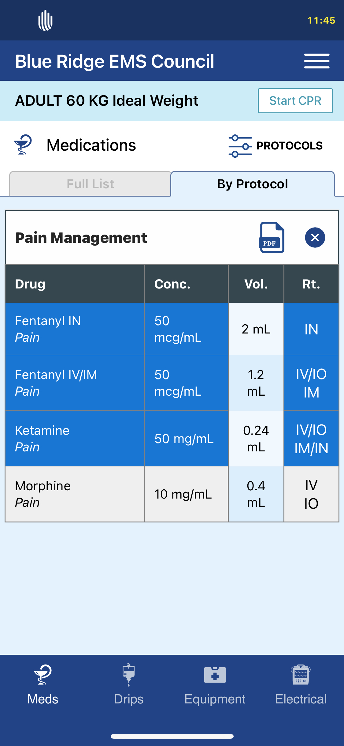
Here you can see that the app will provide you the medications available for use based upon the ideal body weight and protocol that you chose.

Slide 9
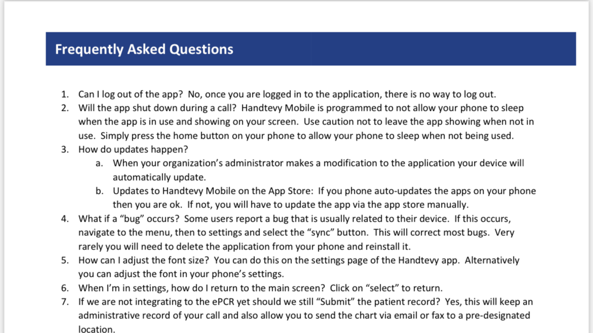

Slide 10
As always, feel free to contact us with questions:
434.947.5934
info@vabrems.org

