Slide 1
All You Need to Know About Hospice for EMS
Barbara Williams DNP, FNP-C (Lead Hospice NP)
April Branham DNP, FNP-C, RN-BC (Hospice NP)

Slide 2
“We cannot change the outcome, but we can affect the journey.”
-Ann Richardson

Slide 3
Objectives
Describe hospice care philosophy for patients across the lifespan and health settings
Understand what hospice care means for patients and their families
Identify who qualifies for hospice care
Identify action to take when EMS is called on a hospice patient
Understand how hospice and EMS can best serve our patients together

Slide 4
Hospice History
Hospice was founded in 1967 by Dame Cicely Saunders in Christopher’s House in London
Place of hospitality for the sick and dying
The first American hospice opened in 1974
In 1986 Medicare Hospice benefit was enacted
In 2004 the number of American’s who received hospice services topped 1 million
Every year 1.6 million people enter hospice care
65% of adults spend their final stage of life in hospice care
Patients admitted to Hospice Services have disease processes with life expectancy of six months or less
(Fast Facts, n.d.)

Slide 5
2015 National Institute of Medicine Report
Decisions and discussions made near the end of life are extremely profound
The dying experience is seen usually as fragmented care, poor symptom management, frequent changes in healthcare settings, and significant responsibilities of family members
Improving quality and honoring individual preferences near the end of life is vital
All people who have advanced illnesses that are close to end of life are entitled to compassionate, high-quality, evidence-based care that are in alignment with their wishes
(Ft, 2015)

Slide 6
Facts About Dying in America Today
60% of American adults live with at least one chronic condition with 40% of these Americans having one or more chronic conditions
Over 3.3 million people died in 2020 in the US
Top leading causes of death in 2020
Heart disease (696,962)
Cancer (602,350)
COVID-19 (350,831)
Accidents/unintentional injuries (200,955)
Stroke/cerebrovascular diseases (160,264)
(Ahmad & Anderson, 2021 & NCCDPHP, 2021)

Slide 7
Serious Illness in America: Impact on Care
Exploding healthcare costs
Healthcare spending in the United States hit $3.8 trillion in 2019 (CMS, 2020)
Misdiagnosis(es)
Failure to treat pain and other symptoms
Increased use of technology
Ethical issues

Slide 8
What is Hospice?
Hospice care is expected to last six months or less if the disease progresses as expected
Patients have a terminal diagnosis and a prognosis of six months or less to live
Focus on symptom management at end of life
Respiratory
Nausea/Vomiting
Constipation
Pain Control
Cardiac
Spiritual
Non-aggressive treatment
Advanced Care Planning discussions take place if needed
IDT meetings every two weeks (multi-disciplinary approach)

Slide 9
What is Palliative Care?
Palliative care can include months to years before a patient is on hospice care
It is for as long as needed
For people nearing end of life
Can start at any point in an illness
Goals of care conversations are started (Advanced Care Planning, DNR, POLST)

Slide 10
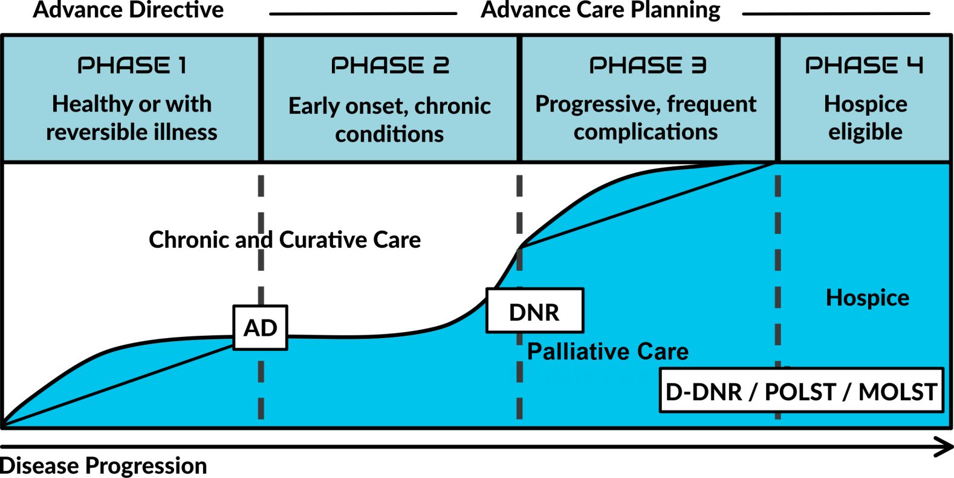
Hospice Care
POLST / MOLST : Portable Medical Orders

Slide 11
Hospice Values
Value people.
Treat everyone with compassion, care, respect and courtesy.
Value the comfort, dignity and safety of our patients, their families and their caregivers.
Value integrity, honesty and ethical behavior.
Value teamwork, open communication and embody a mutual respect.

Slide 12

Hospice Team
Core team: Medical Director, Physicians, Nurse Practitioners, Nurses (RN’s and LPN’s), CNAs, Social Workers, Chaplains, Bereavement Counselors, RN Liaisons, Volunteers
Others as needed: Therapists, Pharmacists, Dieticians

Slide 13
Hospice Services
Hospice is paid a daily fee for services
Regular comprehensive visits by hospice nurses and aides for personal care
Chaplains and social workers (visit frequency per patient request)
24/7 access to on call nurses and provider(s)
Some medications/pain management/symptom control
Medical supplies/equipment such as hospital beds, wheelchairs, oxygen, wound care supplies, etc.

Slide 14
Hospice Services
Help arrange transport for office visits, x-rays, paracentesis, etc.
Volunteers assist families and patients with visits, cards, and medication pick-up if needed
Inpatient care for uncontrolled symptoms (GIP)
Bereavement services for up to one year, support groups (open to the community)
Respite Services (up to five nights)
Does NOT include custodial care

Slide 15
What is Hospice Philosophy?
Hospice philosophy is to ensure that quality of life, peace, and comfort should be the focus when caring for patients at end of life and when all treatment options have been exhausted
The focus is on comfort measures, not curing the patient
Includes spiritual care, physical symptom management, and psychological care

Slide 16
Hospice Levels of Care
Routine home care
General inpatient care
Respite
Nursing home/assisted living care
Hospice House (Bedford)

Slide 17
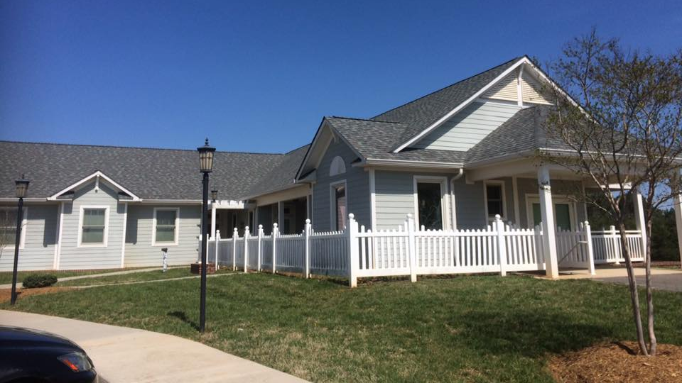
Bedford Hospice House

Slide 18
Benefits of Hospice
Goal is to optimize quality of life.
No one discipline can meet the needs of the patient and family- multidisciplinary team approach is used
Professional and volunteer services are used to meet individual needs.
Focuses on wholistic care which includes psychological, physiological, cultural, and spiritual needs.
Focuses on minimizing pain and suffering

Slide 19
Who Qualifies?
Centra hospice cares for adults aged 18-100+
Medicare, Medicaid, Private Insurance, Self-Pay
Chronic disease
Cancer
Alzheimer’s Disease, dementia
Chronic respiratory diseases, COPD, emphysema,
Heart disease, heart failure, aortic stenosis
Severe protein calorie malnutrition, significant weight loss in a short amount of time
Neurological disorders
CVA, ALS, progressive neurological diseases

Slide 20
Who Qualifies
Patient must have a terminal diagnosis with a prognosis of 6 months or less certified by a physician
Prognosis is based on the terminal illness’ typical course
Each terminal illness has specific eligibility requirements that they must meet
Treatment goals are not curative but palliative
A hospice physician is willing to accept the patient
Per CMS, a patient’s DNR status cannot be used as a criteria for eligibility

Slide 21
Top Reasons EMS is Called for Hospice Patients
Falls
Agitation and Anxiety
Sudden change in condition
Uncontrolled Pain
Dyspnea
Chest Pain
Fear

Slide 22
What to do if EMS gets called and it’s a hospice patient?
Ask if the patient is on Centra hospice
Has hospice been notified?
Call hospice first (434-200-3204)
Options
Comfort kit (morphine/hydromorphone, olanzapine, lorazepam, glycopyrrolate, Dulcolax suppository)
Symptom control from home
If patient still wants aggressive care, then EMT can transport to the ER
Goals of care discussions will need to continue in the hospital

Slide 23
What to do if EMS gets called and it’s a hospice patient?
If patient continues with aggressive care, they need to revoke hospice services
NPs, nurses, social workers, chaplains all round in the hospitals
Patient and Family are educated to call Hospice FIRST for all situations
The DNR and/or POLST Document should be on the refrigerator

Slide 24
How can we best serve our patients together?
Communication
We must both work together to meet the needs of the patient
What if their needs wishes change?
Let hospice know immediately that the patient wishes to go to the ER
It is the patient’s right to change their wishes however we need to know why their wishes have suddenly change
It is okay to transport to the ER, but most symptoms can be managed at home providing the patient still wants non-aggressive care

Slide 25
Key Points
Hospice is end-of-life care for those with a prognosis of six months or less to live and have a terminal diagnosis where there are no more curable options
Hospice philosophy focuses on symptom management, quality of life, and comfort
When EMS is called for a patient, please notify Centra hospice if we have not already been notified
Goals of care discussions are important so that we all understand and respect the patient’s wishes and beliefs
EMS and hospice can work together to serve our patients well
Hospice has a nurse and provider on call 24/7 that are ready to assist with needs
When in doubt, call us! 434-200-3204

Slide 26


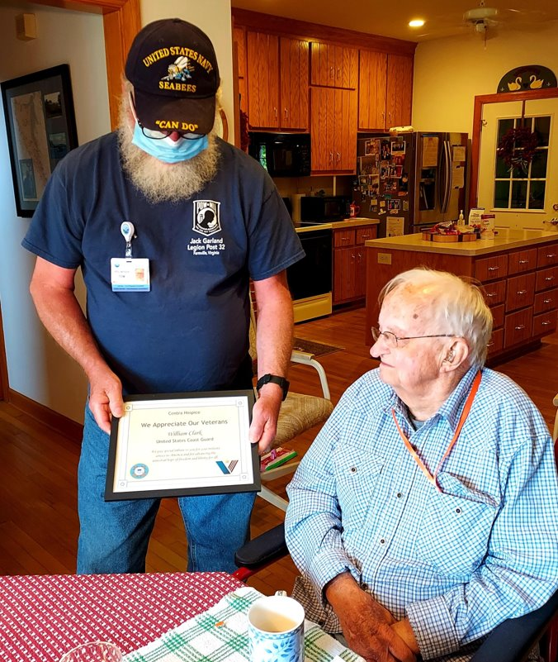
Creating Joy

Slide 27

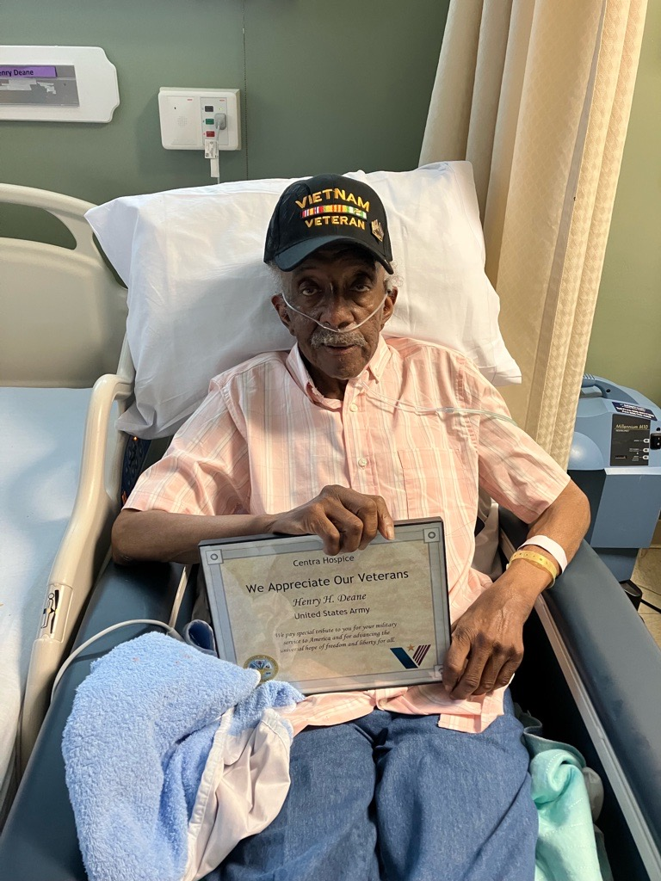
Creating Joy

Slide 28
You matter because you are you, and you matter to the end of your life
- Dame Cicely Saunders

Slide 29

Questions?

Slide 30
References
Ahmad, F., & Anderson, R.N. (2021). The leading causes of death in the US for 2020. JAMA, 325(18), 1829. https://doi.org/10.1001/jama.2021.5469
FastFacts. (n.d.). Hospice Care. https://www.cdc.gov/nchs/fastats/hospicecare.htm
Ft,F. (2015) Dying in America. In National Academies Press eBooks. http://doi.org/10.17226/18748
National Center for Chronic Disease Prevention and Health Promotion (NCCDPHP). (2021). Chronic diseases in America quick facts. Accessed April 1, 2024 from: https://www.cdc.gov/chronicdisease/resources/infographic/chronic-disease.htm

